Slide 1
Presentation Title Goes Here
Subtitle goes here
Presenter Name and Title @Twitter_handle
Session ID

Slide 2
Introduction
Second title goes here
Third title goes here
Fourth title goes here
Fifth title goes here
Conclusion

Slide 3
Deck Flow Notes
1) Introduction slide? Summary of what is Covid-19, its origin, and problem we are addressing. 2) World map with each country filled by gradient for amount of Covid Cases on a certain date 3) Same as above but with continents instead. 4) Line chart of the graph for # of cases in China with best fit line (logarithmic or power function?) 5) Animated line charts of top 5 countries outside of China (Line Apparition in gganimate) 6) Animated map of one country that has growing circles at each of the lat/lon of the province/state over time. 7) Are transmissions correlated to the day of the week? Global daily rate of increase
8) Speak to ML model/algorithm selection and why? – Kalman / Random Forest + Regression/Forecasting
9) Speak to various visualization and why
10) Overall team experience on division of labor and experience with project
11) Questions we had on running analysis on data w/o domain knowledge
12)

Slide 4
Steps for filling in session IDs
Once you have entered your Session ID on the Title Slide:
Copy the Session ID
Insert / Header & Footer / Paste the Session ID into the Footer box
Ensure Slide number and Footer checkboxes are marked
Click “Apply to All”

Slide 5
Demo 2

Slide 6
Color palette
Hero
Use the hero palette colors as much as possible.
Accent colors should only be used to call attention to important details, such as in a chart.
Sky Blue
R 0
G 188
B 235
Midnight Blue
R 13
G 39
B 77
Accent
Ocean Blue
R 30
G 68
B 113
Green
R 116
G 191
B 75
Orange
R 251
G 171
B 24
Red
R 226
G 35
B 26

Slide 7
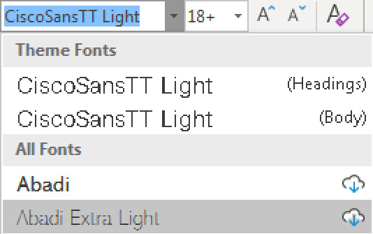
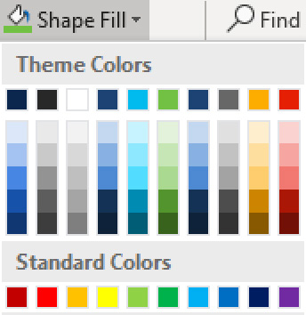
Only use the themes provided
Always use the template themes. It ensures consistency and reduces editing time when you share content between presentations.
Theme fonts
PowerPoint provides two theme fonts – for headings and body. They are found at the top of the font menu.
Do not select fonts from the “All Fonts” section of the list.
Theme colors
Our brand colors are included in the theme color section. Use only these colors and associated tints/shadows.
Do not use Standard Colors or create custom colors.

Slide 8
Seven tips for better presentations
Tell a story—make them care
Start with what’s most important to them
Keep it simple, and short
Use more slides with less on them, and cut any slides that you can
Use clear, natural language
Make it a conversation and leave time to listen
Tell them what to do next—get them to act

Slide 9
Layout: Title and subtitle
Subtitle: Size 18, left aligned

